Slide 1
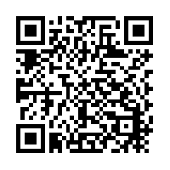

Slide 2
NOW SHOWING
Theatre Survival 101
Notes:
Marquee with 3-D perspective rotation
(Intermediate)
To reproduce the effects on this slide, do the following:
On the Home tab, in the Slides group, click Layout, and then click Blank.
On the Home tab, in the Drawing group, click Shapes, and then under Rectangles click Rectangle (first option from the left). On the slide, drag to draw a rectangle.
Under Drawing Tools, on the Format tab, in the Size group, do the following:
In the Shape Height box, enter 3.12”.
In the Shape Width box, enter 7.67”.
On the Home tab, in the Drawing group, click the arrow next to Shape Fill, and then click No Fill.
On the Home tab, in the Drawing group, click the arrow next to Shape Outline, and then click No Outline.
Right-click the rectangle, and then click Edit Text.
Enter text in the text box, and then select the text. On the Home tab, in the Font group, select Franklin Gothic Medium from the Font list, enter 50 in the Font Size box, and then click Bold.
On the Home tab, in the Paragraph group, click Center to center the text in the text box.
Under Drawing Tools, on the Format tab, in the WordArt Styles group, click the arrow next to Text Fill, point to Gradient, and then click More Gradients.
In the Format Text Effects dialog box, click Text Fill in the left pane, select Gradient fill in the Text Fill pane, and then do the following:
In the Type list, select Linear.
Click the button next to Direction, and then click Linear Down (first row, second option from the left).
In the Angle box, enter 90°.
Under Gradient stops, click Add gradient stop or Remove gradient stop until three stops appear in the drop-down list.
Also under Gradient stops, customize the gradient stops that you added as follows:
Select the first stop in the slider, and then do the following:
In the Position box, enter 0%.
Click the button next to Color, click More Colors, and then in the Colors dialog box, on the Custom tab, enter values for Red: 80, Green: 80, Blue: 80.
Select the next stop in the slider, and then do the following:
In the Position box, enter 49%.
Click the button next to Color, click More Colors, and then in the Colors dialog box, on the Custom tab, enter values for Red: 89, Green: 89, Blue: 89.
Select the last stop in the slider, and then do the following:
In the Position box, enter 50%.
Click the button next to Color, and then under Theme Colors click Black, Text 1 (first row, second option from the left).
Also in the Format Text Effects dialog box, click Shadow in the left pane. In the Shadow pane, click the button next to Presets, and then under Outer click Offset Center (second row, second option from the left).
On the Home tab, in the Drawing group, click Shapes, and then under Rectangles click Rounded Rectangle (second option from the left). On the slide, drag to draw a rounded rectangle.
Select the rounded rectangle. Under Drawing Tools, on the Format tab, in the Size group, do the following:
In the Shape Height box, enter 3.12”.
In the Shape Width box, enter 7.67”.
Drag the yellow diamond adjustment handle at the top of the rounded rectangle to adjust the amount of rounding on the corners.
Under Drawing Tools, on the Format tab, in the Shape Styles group, click the arrow next to Shape Fill, point to Gradient, and then click More Gradients.
In the Format Shape dialog box, click Fill in the left pane, select Gradient fill in the Fill pane, and then do the following:
In the Type list, select Linear.
Click the button next to Direction, and then click Linear Right (first row, fourth option from the left).
In the Angle box, enter 0°.
Under Gradient stops, click Add gradient stop or Remove gradient stop until two stops appear in the slider.
Also under Gradient stops, customize the gradient stops that you added as follows:
Select the first stop in the slider, and then do the following:
In the Position box, enter 0%.
Click the button next to Color, and then under Theme Colors click White, Background 1 (first row, first option from the left).
Select the last stop in the slider, and then do the following:
In the Position box, enter 100%.
Click the button next to Color, and then under Theme Colors click White, Background 1, Darker 25% (fourth row, first option from the left).
Also in the Format Shape Effects dialog box, click Line Color in the left pane. In the Line Color pane, select No line.
Select the rounded rectangle. On the Home tab, in the Clipboard group, click the arrow to the right of Copy, and then click Duplicate.
Select the duplicate rounded rectangle. On the Home tab, in the Drawing group, click the arrow next to Shape Fill, and then click No Fill.
On the Home tab, in the Drawing group, click the arrow next to Shape Outline, and then under Theme Colors click White, Background 1 (first row, first option from the left).
On the Home tab, in the Drawing group, click the arrow next to Shape Outline, point to Weight, and then click More Lines. In the Format Shape dialog box, click Line Style in the left pane, and then do the following in the Line Style pane:
In the Width box enter 10 pt.
Click the button next to Dash type, and then click Round Dot (second option from the top).
In the Cap type list, select Round.
On the Home tab, in the Drawing group, click Shape Effects, point to Glow, and then do the following:
Under Glow Variations, click Accent color 1, 11 pt glow (third row, first option from the left).
Point to More Glow Colors, and then click More Colors. In the Colors dialog box, on the Custom tab, enter values for Red: 255, Green: 233, Blue: 33.
Under Drawing Tools, on the Format tab, in the Size group, do the following:
In the Shape Height box, enter 3.53”.
In the Shape Width box, enter 8.05”.
On the Home tab, in the Drawing group, click Shapes, and then under Lines click Line (first option from the left).
Press and hold SHIFT to constrain to a straight, horizontal line, and then drag to draw a horizontal line on the slide.
Select the line. Under Drawing Tools, on the Format tab, in the Size group, in the Shape Width box, enter 7.67”.
On the Home tab, in the Drawing group, click the arrow next to Shape Outline, and then do the following:
Under Theme Colors, click Black, Text 1, Lighter 50% (second row, second option from the left).
Point to Weight, and then click 1 1/2 pt.
Select the line. On the Home tab, in the Clipboard group, click the arrow to the right of Copy, and then click Duplicate. Repeat the process for a total of eight straight lines.
On the Home tab, in the Editing group, click Select, and then click Selection Pane.
In the Selection and Visibility pane, select the first rectangle that contains text. On the Home tab, in the Drawing group, click Arrange, and then click Bring to Front.
Also in the Selection and Visibility pane, press and hold CTRL and select all three rectangle objects. On the Home tab, in the Drawing group, click Arrange, point to Align, and then do the following:
Click Align to Slide.
Click Align Center.
Click Align Middle.
Drag each of the straight lines onto the gradient-filled rectangle, spacing them vertically as evenly as possible.
In the Selection and Visibility pane, press and hold CTRL and select all eight straight connector objects (the lines). On the Home tab, in the Drawing group, click Arrange, point to Align, and then do the following:
Click Align Selected Objects.
Click Distribute Vertically.
Click Align Center.
Press CTRL+A to select all of the objects on the slide. On the Home tab, in the Drawing group, click Arrange, and then click Group.
Select the group. On the Home tab, in the Drawing group, click Shape Effects, point to 3-D Rotation, and then under Perspective click Perspective Right (first row, third option from the left).
Drag the group slightly to the right on the slide to position it in the center.
To reproduce the background effects on this slide, do the following:
Right-click the slide background area, and then click Format Background. In the Format Background dialog box, click Fill in the left pane, select Gradient fill in the Fill pane, and then do the following:
In the Type list, select Linear.
Click the button next to Direction, and then click Linear Down (first row, second option from the left).
Under Gradient stops, click Add gradient stop or Remove gradient stop until four stops appear in the slider.
Also under Gradient stops, customize the gradient stops that you added as follows:
Select the first stop in the slider, and then do the following:
In the Position box, enter 0%.
Click the button next to Color, and then under Theme Colors click Dark Blue, Text 2 (first row, fourth option from the left).
Select the next stop in the slider, and then do the following:
In the Position box, enter 15%.
Click the button next to Color, and then under Theme Colors click Black, Text 1, Lighter 5% (sixth row, second option from the left).
Select the next stop in the slider, and then do the following:
In the Position box, enter 85%.
Click the button next to Color, and then under Theme Colors click Black, Text 1, Lighter 5% (sixth row, second option from the left).
Select the last stop in the slider, and then do the following:
In the Position box, enter 100%.
Click the button next to Color, and then under Theme Colors click Dark Blue, Text 2 (first row, fourth option from the left).

Slide 3
Tana Howard
Sands CISD
Counselor, Theatre, Yearbook Finance
10 Years as OAP Director JH/HS

Slide 4
Jay Sedberry
Ropes ISD
Technology Director, Social Studies, Math
6 Years as OAP Director

Slide 5
Selecting a Show
- Drama/Comedy
- What best suits your kids?
- What are you comfortable with?
- It is ok to get out of your comfort zone?
- On Approved List /Getting Approval
- List of previously produced plays
- One-Act/Full Length

Slide 6
Scenes From…
- From Full Length Plays
- DO NOT use the word CUTTING!!!!!
- Tell a story
- Who’s story do you want to tell?
- Are there certain characters that you want to highlight?
- Which Characters do you need to use to tell your story?
- Where/How do you want to begin the play?
- Where/How do you want to end the play?
- Doubling Characters

Slide 7
Casting
- Cutting characters
- Auditions
Blind draw for a partners
Sometimes we will have a monologue for them to read
- Recommend piece is memorized, but not a criteria
- Google form
- Fill out during audition
- Results are posted to a spreadsheet and we can sort results
- All aspects of audition are taken into consideration when casting because we know all kids at Ropes and Sands, we can also take personality into consideration.

Slide 8
Directing
Telling a story
How do you want to tell your story on stage?
Decide how you want to use your space.
Literal vs. abstract
Does the script leave any room for creativity?

Slide 9
Directing
- Literal
The Effect of Gamma Rays on Man in the moon Marigolds
Leading Ladies
Limbo
- Abstract
- To See the Stars
- Rimers of Eldritch
- Nevermore

Slide 10
Directing
Stage Pictures
You want the audience member to feel like they are watching a movie at the theatre.
Rule of three
Make a triangle
No straight lines
You can have straight lines, but be ready to explain to a judge why you chose to have them.

Slide 11
Directing
Balanced stage?
Levels
Set
People

Slide 12
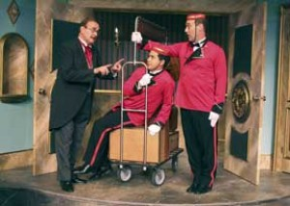

Slide 14
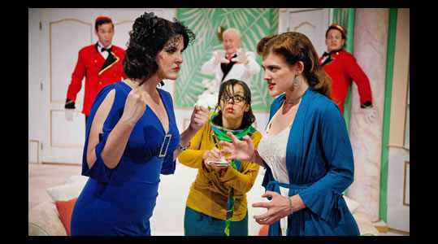

Slide 17
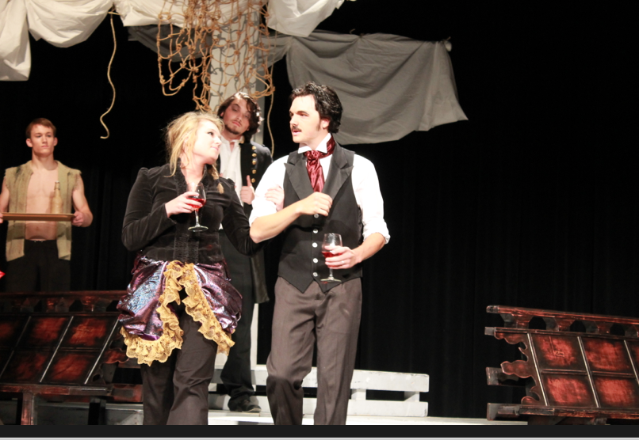

Slide 18
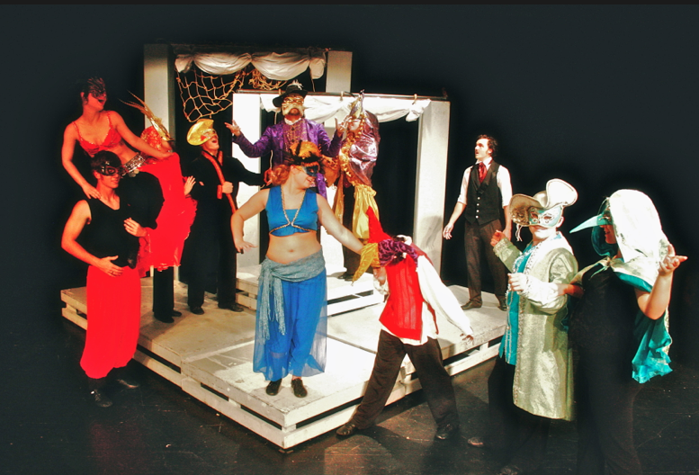

Slide 19
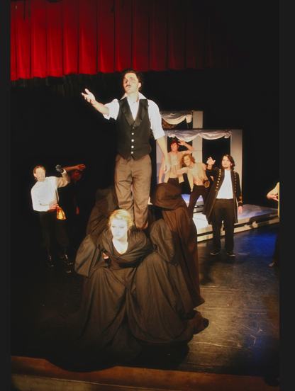

Slide 20
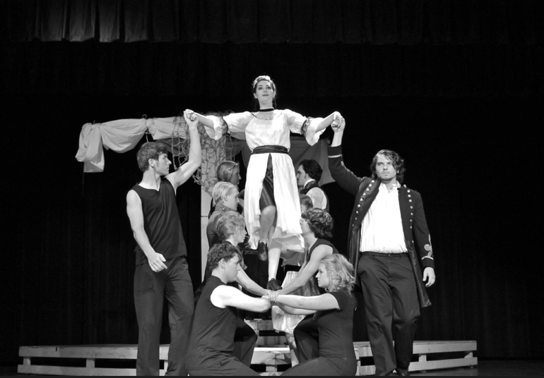

Slide 21
Directing
Characters Move with a purpose
Act and React
Soap Opera Acting

Slide 22
Directing
Keep it Fresh
Off Script ASAP!!!
Give deadlines

Slide 23
Directing
Remember, you only have 40 minutes, so you may have to make more cuts
General rule of thumb, 1 minute/page
Make the acting/line delivery real
Research the time period with your students
Youtube

Slide 24
Directing
Do them or not
Everyone has to buy in 100%
Start working on them yesterday
Have kids talk in accent all day long
Put actors in charge
Online resources to help.
www.accenthelp.com
Youtube

Slide 25
Directing
Costuming
Making
Goodwill/Thrift Stores
Renting
Google how to make costumes very cheaply

Slide 26
Directing
Make-up
Eye-Liner
Guy-Liner
Make up kit for everyone
Crème Personal Kit
$19.95 @ Theatre House
Use a color that compliments skin tone
Old Age Makeup
Shading/Blending

Slide 27
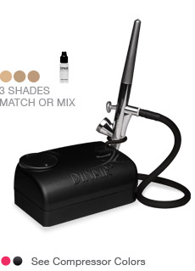
Airbrush Makeup
Dinair
$99-299

Slide 28
Directing
Music
Time Period Appropriate
Leading Ladies (1950’s)
Istanbul (Not Constantinople)
Movie Music
To See the Stars (1909)
Klezmer Suite No 1
Reel Around the Sun (Celtic Experience)-Bridget Monologue 2:43-3:13
Rowena’s Theme (Mr. Holland’s Opus)
Remembrances- Schindler’s List

Slide 29
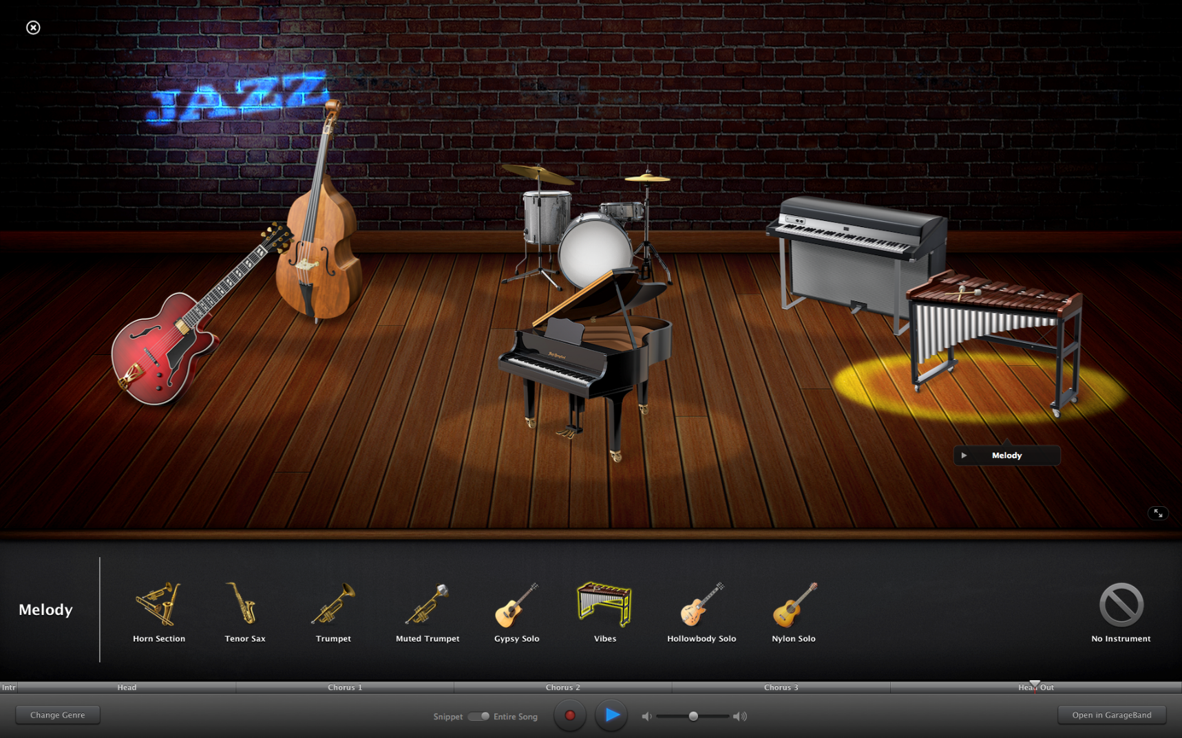
Directing
Cutting Music
Garage Band

Slide 30
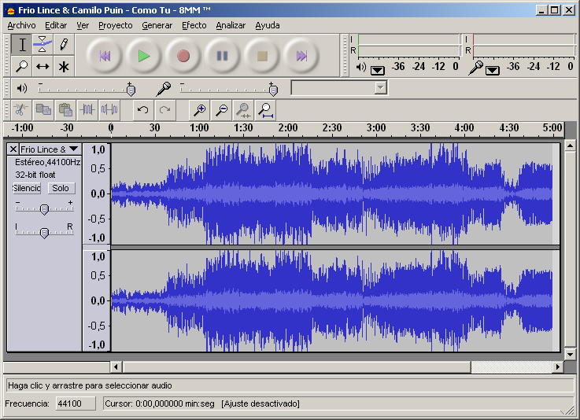
Directing
Cutting Music

Slide 31
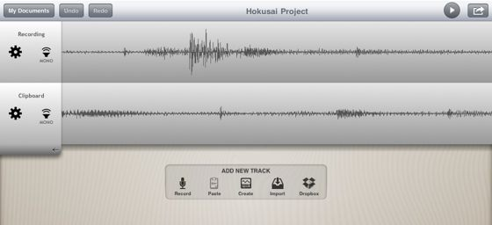
Directing
Cutting Music

Slide 32
Building a Theatre Program in Small Schools
Administrative and School Support
Community & Parent
Other programs
Work within Budget
Account for all Money
Be on top of Paperwork
Good Communications
Build Good Relationships with key players
Involve your Superintendent or Principal
Judge UIL speaking events, Ag speaking and talent events, pageants

Slide 33
2. Avoid Conflicts with other Activates
Theatre Production Class and try to get actors in this class
Morning Rehearsals
Official rehearsal schedule
Double cast your show
Evening rehearsals after all other events
Performance Dates
Fall Show-Open Football game date
Saturday shows-matinee and late show with a Fundraiser meal between shows

Slide 34
3. Build your Program Numbers
Fun Family Type atmosphere with productions and projects year round
JH Class to build your HS in the future
Produce 1 show
Attend OAP Contest
Basics, Basics, Basics
Be Flexible- allow active students in your show
One “Fun” show a year-Fall, Variety, Elem Musicals
Summer Theatre Camp
Encourage HS Students to attend Summer Camps
Organize a Thespian Troupe
DRAMA CLUB!!!!
NYC Trip with Tour Guide-You Travel Free
Attract Non Acting Students- Tech Kids
Art-Scene painting publicity design
FCCLA-Fashion costuming
Computer Kids-Tech Design
Ag-SETS!!!!!
Music-Sound

Slide 35
4. Facilities
Don’t let them stop you
All you need is an open space
Take it on the road-Community Theatre
Facility Usage
Guidelines and rules
Calendar
Maintenance
They too need a calendar
5 Year Plan
Video Monitor
For dressing rooms, light and sound booth
Baby monitors-Garage Sales!!!

Slide 36
5. Networking, Professional Development
FACEBOOK!!!!
UIL UIL One Act Play Directors
UIL One Act Play Contest Managers
UIL Academic Coordinators
Texas UIL speech & debate judges and coaches
UIL Prose & Poetry
UIL Filmaking
Members of your Faculty
Sewing
Music
AG!!!!
Technology
Festivals/Clinics
Go to as many as you can!!! Helps not only the kids but you as well
Conferences
TETA in January
Capital Conference in July
TETA SummerFest in July
UIL Activity Conferences in the Fall
UIL STATE MEET!!!

Slide 37
Make your program visible to the community
Half time show
Relay for Life
Pep Rallys
Halloween/Christmas charity events
Seasonal production in different venues
Perform local nursing homes

Slide 38
“FUN”draising
Ad sell for programs
Parents/Grandparents
Dinner Theatre
Live/Silent Auction
Admission/or Donations to shows
Sell t-Shirts
Yard Signs
Community Cook Books
Variety Show
Haunted House
Children Show
Departmental Support Cards for businesses
Season Tickets
SCENTSY!!!!

Slide 39
OAP Notebook
Plastic sheet protector
Integrity Script
Eligibility
Proof of Royalty
Community Compliance
Music Log
2. Calendar
Rehearsals, Competitions, Festivals

Slide 40
OAP Notebook
8 Tabs
Script
Competition Information
Receipts
UIL
Festival Info
Travel
Costumes
Cast & Crew

Slide 41
Things to Remember
Eligibility Notice (10 days Prior)
Proof of Royalty Payment/ Permission to Cut (Rehearsal)
Play Set Additional Approval (Rehearsal)
Community Compliance (Rehearsal)
Official Script (Rehearsal)
Music Log (Rehearsal)

Slide 42
Resources OAP
Teacher Training Network Web Sites: UIL Theatre page - http://www.uiltexas.org/theatre Texas Education Agency - http://www.tea.state.tx.us/ Center for Educational Development in Fine Arts - http://www.cedfa.org Educational Theatre Association - www.edta.org Texas Art Education Association - www.taea.org Texas Dance Educators Association - www.tdea.org Texas Music Educators Association - www.tmea.org Association of Texas Small School Bands - www.atssb.org Texas Theatre Exchange - http://txtheatreexchange.blogspot.com/ Go Arts - http://www.goarts.org ACT OUT - http://actout.wikidot.com/ A theatre resource for underresourced high schools

Slide 43
Medals & Patches:
Southwest Emblem - www.southwestemblem.com
Theatre Supplies:
Goboman - www.goboman.com
Olden Lighting - www.oldenlighting.com
Performing Arts Supply Co. - www.performingartssupply.com
Texas Scenic - www.texasscenic.com
Stage Stars Records (accompaniment CDs for school musicals) - www.stage-stars.com

Slide 44
Consultants:
Teqniqal Systems - www.teqniqal.com
Theatre Design Services, LLC - www.theatredesignservices.com
Unit Set Vendors:
J and J Wood Works - http://www.jandjwoodworks.com/
Palco Specialties - palcospecialties.com
Unit Sets Unlimited - www.unitsetsunlimited.com

Slide 45
Texas Theatre Exchange
https://sites.google.com/site/uiloneactplaydirectors/
UIL Website
http://www.uiltexas.org/theatre/high-school-one-act
Letter from Luis to students
http://www.uiltexas.org/files/academics/theatre/letter-to-students.pdf
Guidelines for Theatre Safety
http://www.uiltexas.org/files/academics/theatre/theatre-safety-manual.pdf
Theatre Folk
https://www.theatrefolk.com/free-resources

Slide 46
Texas Tech
UIL Theatre Workshop
Oct 3-4, 2014

Slide 47
TheatreFest 2015
Houston, Texas
Jan. 29 - Feb. 1
Co-Convention Directors,
Jerry Ivins and Missey Head
-------------------------------------------

Slide 48
Student Activity Conferences
September 13 - West Texas A&M University, Canyon
★ They're free! No pre-registration needed!
★ The Conferences begin at 9 a.m. and end by 1:30 p.m. without a lunch break. This allows us greater flexibility in scheduling without sacrificing program quality, and allows schools to return home earlier. Bring along snacks for students who need a sugar or carbo boost around noon.
★ Conferences are scheduled as best as possible to minimize conflicts with national testing dates, band contests and state conventions and to maximize participation by the finest students and teachers in Texas. Pre-registration is not required and there is no fee for attendance.
★ Instructional Sessions are designed for beginning students, advanced students and academic coordinators and coaches. Lectures and demonstrations will be scheduled for all UIL academic contests, including One-Act Play.
★ Conferences feature lectures and presentations by UIL contest directors, college professors and high school teachers. Sessions will include discussions on contest preparation, demonstrations, performances and contest administration. Students may choose from novice and advanced sessions in some academic areas, as well as small-group sessions in specific UIL activities.
★ Bring students! Most sessions are intended to help students begin preparing for high school spring contests. Mark your calendar and plan to attend one or more of these free conferences.
★ Tentative programs for each site will be posted on the UIL web site, and final programs will be available at each site.

Slide 49
Technical Design
Design Prompt-Cats
by Andrew Lloyd Weber
http://www.uiltexas.org/theatre/theatrical-design

Slide 50
Apps
The Great Improv Generator
ModiFace-Photo Editor
Make-up Touch 2
Dress up National Costumes
Design it-Outfit Maker
Recorder Plus II
7. Notes-Print/email to Cast/Crew

Slide 51
itunes
Books
Shakespeare in an Hour-Free
Audio Books
Classic Radio Christmas Plays
I tune U
National Theatre
Courses
PodCasts
Of Mice and Men

